Slide 1
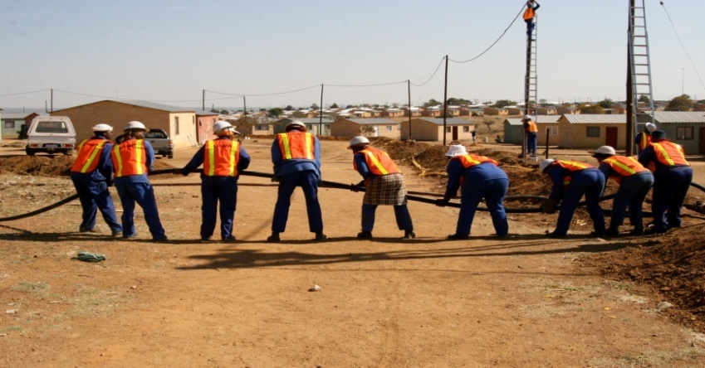
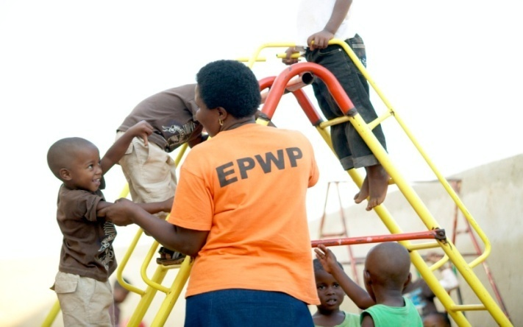
Expanded Public Works Programme 2018 Summit Commission 1: Governance and Coordination Mechanisms feedback

Slide 2
Commission 1: Governance and Coordination Mechanisms
Issue | Action and Proposal | Responsibility | Time Frames
1. Accountability: How do we ensure accountability and enforcement in the implementation of EPWP across all levels of government? | Noting: There is a need for a vertical (political) and horizontal (administrative) accountability The current level of accountability is at a higher level (HODs) and does not cascade to lower levels. Accountability is limited to project implementation and excludes targets No enforceability Proposal: All accounting Officers should have EPWP as part of performance agreements with reasonable weights min. 20% Planning and budgeting process should be used to mainstream EPWP. | All accounting Officers | 30 June 2019
Notes:
In setting the scene the facilitator should cover:
Current institutional arrangement in EPWP,
SWOT analysis of the existing institutional arrangement,

Slide 3
Commission 1: Governance and Coordination Mechanisms
Issue | Action and Proposal | Responsibility | Time Frames
1. Accountability: How do we ensure accountability and enforcement in the implementation of EPWP across all levels of government? | Noting: Misalignment of decision and lack of clarity on accountability. Proposal: All existing IGR structures to have EPWP as a standing agenda item. A consideration for the joint MinMec to include all sectors to promote overall accountability. (DPW, DSD, DEA and COGTA) | Provincial Coordinating Departments DPW, DEA, DSD and COGTA | Ongoing Ongoing
Notes:
In setting the scene the facilitator should cover:
Current institutional arrangement in EPWP,
SWOT analysis of the existing institutional arrangement,

Slide 4
Commission 1: Governance and Coordination Mechanisms
Issue | Action | Responsibility | Time Frames
2. Institutional arrangements for better coordination: How to improve coordination mechanisms and efficiency in the Programme including coordination of sectors and lead departments? | Noting : Most public bodies do not have dedicated resources (HR, finance, etc.) for EPWP implementation. Lack of EPWP Structure in the organograms. EPWP still politized at local sphere. Transversal reporting between accounting officers and political principals. | n/a | n/a
Notes:
In setting the scene the facilitator should cover:
Current institutional arrangement in EPWP,
SWOT analysis of the existing institutional arrangement,

Slide 5
Commission 1: Governance and Coordination Mechanisms
Issue | Action | Responsibility | Time Frames
2. Institutional arrangements for better coordination: How to improve coordination mechanisms and efficiency in the Programme including coordination of sectors and lead departments? | Proposal All public bodies to adopt and implement a generic EPWP Structures. (Matatiele, Umkhambathi etc). Adequate resourcing to be set aside for effective and efficient EPWP coordination. All municipal councils to be inducted by 31 Dec 2019. All Public bodies to establish internal EPWP steering committees for monitoring and evaluation of EPWP. | Sectors and Provincial DPW – monitors progress | 31 December 2019
Notes:
In setting the scene the facilitator should cover:
Current institutional arrangement in EPWP,
SWOT analysis of the existing institutional arrangement,

Slide 6
Commission 1: Governance and Coordination Mechanisms
Issue | Action | Responsibility | Time Frames
2. Institutional arrangements for better coordination: How to improve coordination mechanisms and efficiency in the Programme including coordination of sectors and lead departments? | Noting The location of the Programme in terms of coordination and transversal accountability (Minister to Minister/HOD to HOD). Proposal: DPW to fast track engagement with all relevant stakeholders and come up with clarity on the Programme location and be included in the National EPWP Policy. | DPW | 31 March 2020
Notes:
In setting the scene the facilitator should cover:
Current institutional arrangement in EPWP,
SWOT analysis of the existing institutional arrangement,

Slide 7
Commission 1: Governance and Coordination Mechanisms
Issue | Action and Proposal | Responsibility | Time Frames
3. Governance and relationship framework: Protocol Agreement and Memorandum of Understanding – How should they be structured and enforced to ensure that EPWP is implemented? | Noting: Limited buy-in of existing protocol agreements by new mayors after Local Government Elections. Lack of involvement of other key political heads as signatories in the Protocol Agreement. Lack of protocol agreements for provincial departments. | n/a | n/a
Notes:
In setting the scene the facilitator should cover:
Current institutional arrangement in EPWP,
SWOT analysis of the existing institutional arrangement,

Slide 8
Commission 1: Governance and Coordination Mechanisms
Issue | Action and Proposal | Responsibility | Time Frames
3. Governance and relationship framework: Protocol Agreement and Memorandum of Understanding – How should they be structured and enforced to ensure that EPWP is implemented? | Proposal MECs: DPW, COGTA, Premiers to be included in the signing of the Protocol Agreements . Mayors to be workshopped on the Protocol Agreements for better understanding and enforcement. Addendum to be signed in case there is a newly elected mayors. Public bodies not to set targets in their APP lower than EPWP assigned targets. | Sectors and Provincial DPW – monitors progress | 31 March 2020
Notes:
In setting the scene the facilitator should cover:
Current institutional arrangement in EPWP,
SWOT analysis of the existing institutional arrangement,

Slide 9
Commission 1: Governance and Coordination Mechanisms
Issue | Action | Responsibility | Time Frames
3. Governance and relationship framework: Protocol Agreement and Memorandum of Understanding – How should they be structured and enforced to ensure that EPWP is implemented? | Sections of the EPWP Policy should be institutionalised (phased –approach) Convergence across all spheres of government should be strengthened | Sectors and Provincial DPW | Ongoing
Notes:
In setting the scene the facilitator should cover:
Current institutional arrangement in EPWP,
SWOT analysis of the existing institutional arrangement,

Slide 10
Commission 1: Governance and Coordination Mechanisms
Issue | Action/Proposals | Responsibility | Time Frames
3. Governance and relationship framework: Protocol Agreement and Memorandum of Understanding – How should they be structured and enforced to ensure that EPWP is implemented? | Clear TOR for coordination at all Spheres with roles and responsibilities – agree on one set of targets. Develop a National SOP on the implementation of EPWP TOR to bring COGTA as a strategic partner in the coordination of EPWP at municipal level | DPW | 31 March 2020
Notes:
In setting the scene the facilitator should cover:
Current institutional arrangement in EPWP,
SWOT analysis of the existing institutional arrangement,

Slide 11
I thank you

